Slide 1
Heart Failure Predictions
Tyler Anderson
Notes:
The dataset we are using includes features that are factors in determining the risk for CVD. It is the number 1 cause of death globally, taking an estimated 17.9 million lives each year, which accounts for 31% of all deaths worldwide. Heart failure is a common event caused by CVDs and this dataset contains 12 features that can be used to predict mortality by heart failure. Most cardiovascular diseases can be prevented by addressing behavioral risk factors such as tobacco use, unhealthy diet and obesity, physical inactivity and harmful use of alcohol using population-wide strategies. People with cardiovascular disease or who are at high cardiovascular risk (due to the presence of one or more risk factors such as hypertension, diabetes, hyperlipidemia or already established disease) need early detection and management where a machine learning model can be of great help.

Slide 2






Cardiovascular diseases (CVDs)
Notes:
My hypothesis is that high blood pressure is the variable that contributes the most to death events in patients. I want to see if I can predict based on the variables given the risk of a patient dying of heart disease. I plan to use model fitting for multiple models and compare the results to determine the best fitting model for this data.

Slide 3
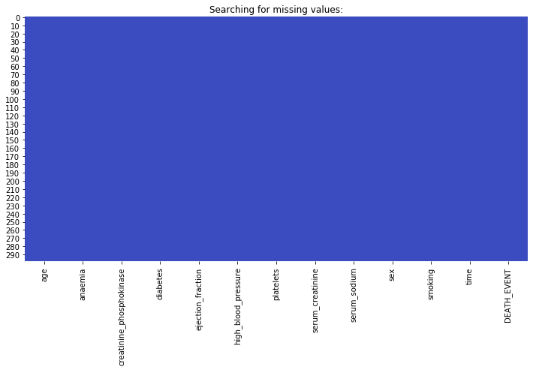
Analysis – Missing values
No missing values in the dataset
Missing values would show up as red
Notes:
Using seaborn I used a heatmap to discover any missing values. A heatmap makes it easy to visualize the missing values in our dataset.

Slide 4
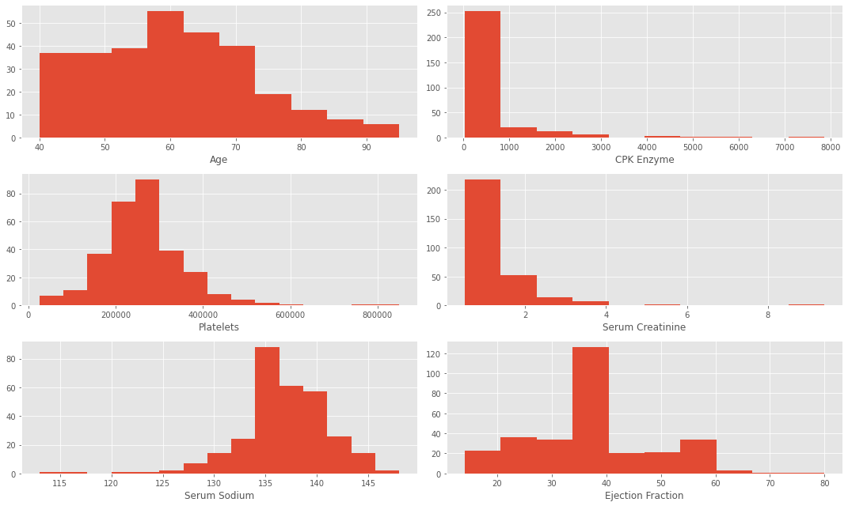
Analysis – Outliers of Continuous Features
We can see that the majority of patients are around 50-65 with around one third of them above 65.
CPK Enzyme shows the most blatent outliers with the other variables containing some as well.
Notes:
Next, we look our continuous variables for outliers and general information
We can see that the majority of patients are around 50-65 with around one third of them above 65. When looking at Creatinine Phosphokinase (CPK) we can confirm the outliers based on this histogram as well as the other features, ejection fraction, serum sodium, platelet counts and creatinine. Most of the patients CPK values are below 1,000. Platelets were between 150k-400k. Serum Creatinine values were below 2 for 75% of patients. Sodium values were between 132-142. Ejection Fraction was varied as some patients were low at around 15% or high at 55% when excluding outliers.

Slide 5
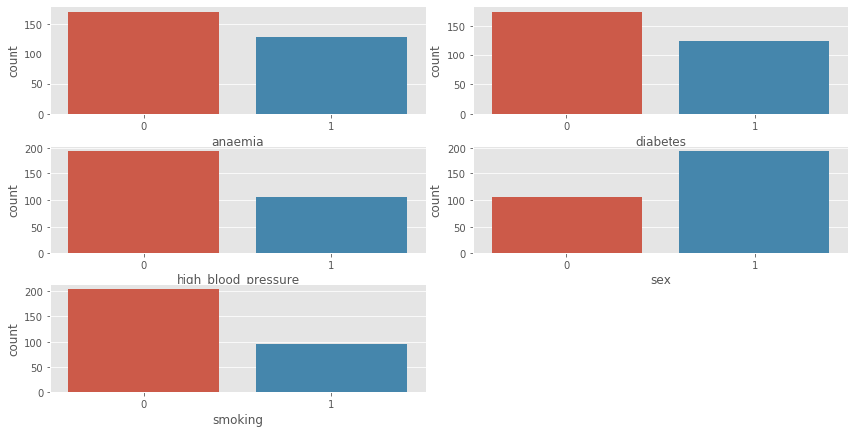
Analysis – Categorical Features
The majority of patients were male about 65% with 1 being Male
Around 40% of patients had diabetes, anemia or both
Notes:
Next, we can see the distributions of the categorical variables. I looked at anemia, diabetes, high blood pressure, sex and smoking as they were binary so it would be easy to spot some differences and gain some insight. The majority of patients were male about 65% with 1 being Male. About a third of patients suffered from high blood pressure, smoking or both at once. Around 40% of patients had diabetes, anemia or both as well.
Based on our analysis so far, we can make some basic assumptions before we continue Women may have higher chances of survival than men
Those who had less time in follow up days had higher chances of survival
Those who were younger than a certain age had higher chances of survival

Slide 6





Analyzing relationships between survival and categorical variables via grouping
Our previous assumptions might be wrong
Notes:
I also wanted to see the relationship between the same variables but against the death event variable to take a look at sex, smoking, anemia, diabetes and high blood pressure to see if there were strong correlations between them and the death event. After evaluation I notice there is not any obvious correlation between their sex or whether they smoked against whether they died or not.

Slide 7
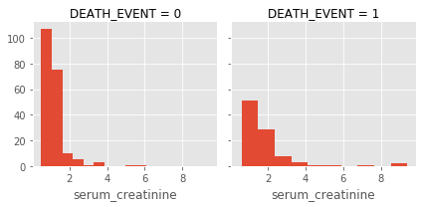
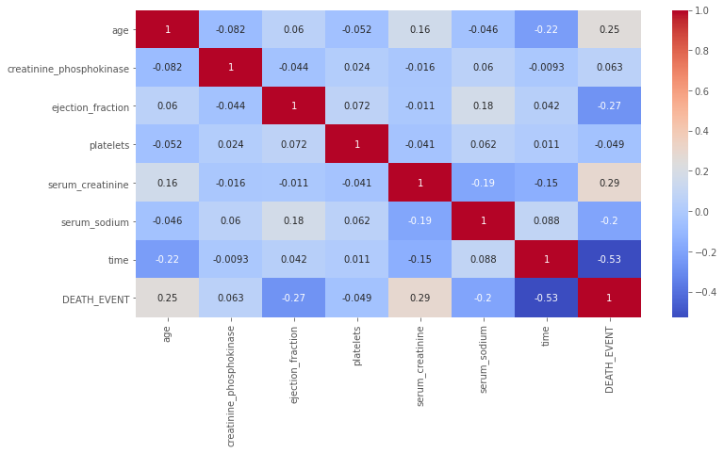
Analysis - Heatmap
Serum creatinine has a high correlation comparatively
Notes:
This heatmap gives us a good visual for looking at the most impacted variables against the death event (weather a patient dies while being monitored by doctors)
After looking at the heatmap we can see that the highest correlation is the serum creatinine variable.
This gives us the ability to take a deeper look at this variables and see if we can come to any conclusions with it.

Slide 8
Analysis
Individuals over 70 had higher chances of dying
Those under 50 had higher chances of survival
Patients with a larger amount of follow up days had a higher survival rate
Those with greater than 50 days ended up with a higher mortality
Notes:
Based on all the plots and visualizations we can see that individuals especially over 70 had higher chances of dying and those under 50 had higher chances of survival suggesting the need to band ages. Patients with a larger amount of follow up days tended to survive the most while those with greater than 50 days ended up with a higher mortality.

Slide 9
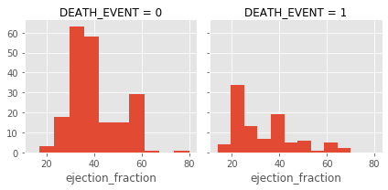
Analysis
Ejection fraction showed those with high percentages had lower deaths and those with lower percentages of about less than 30% had more deaths
Two features, Platelets and CPK, seem to not have any effect with survival.
Notes:
Another interesting thing was the ejection fraction, those with high percentages had lower deaths and those with lower percentages of about less than 30% had more deaths. Two features, Platelets and CPK, seem to not have any effect with survival. So, we have four numerical variables that can be used for our future model building.

Slide 10
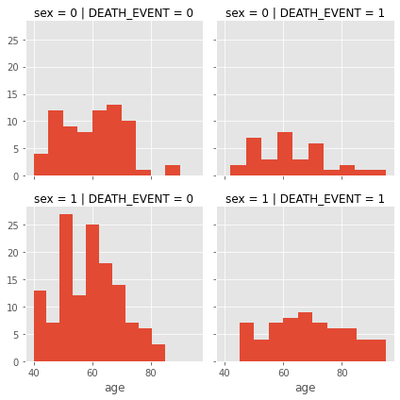
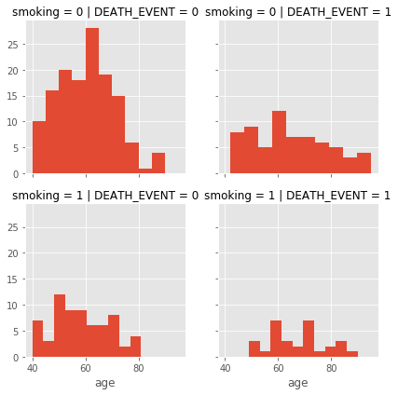
Analysis – Smoking against age
No real relationship with smoking and sex when splitting each up.
Notes:
Looking at the plot for smoking against age we don’t see much of a relationship even when we split into whether a patient smokes or not, the same can be said for sex so we can be confident in dropping these two variables in this analysis. Overall, the most useful features currently are time, serum creatinine and the ejection fraction.
However, at the same time we can create a new column indicating whether a patient has any underlying condition whether it be anemia, high blood pressure or diabetes. However, after creating a new column and comparing it to the death event it still does not give us any correlation so we can also drop this newly created variable variable.

Slide 11

Modelling
Logistic Regression
KNN or k-Nearest Neighbors
Support Vector Machines
Naive Bayes classifier
Decision Tree
Random Forrest
Perceptron
Artificial neural network
RVM or Relevance Vector Machine
Notes:
After removing outliers, we can create our training and test sets. Since this is a classification and a regression problem, we can predict an output based off other independent features, additionally as this is a supervised problem as we will have a training dataset to train our model against. Here are the models I will be using as they all can be used similarly to one another for this project.

Slide 12
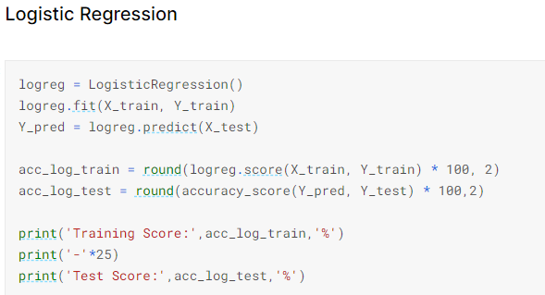
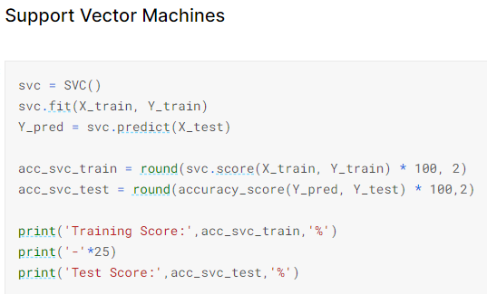
Model fitting
Each type of model can be used similarly for this problem
Notes:
Most of the models can be used similarly to the ones shown here making the use of multiple models to compare against an easier task.

Slide 13
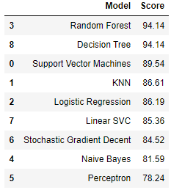
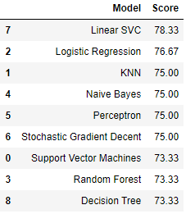
Results and conclusions
Training
Test
Notes:
Based on our results it would seem that the Linear SVC model produces our best results of 78.3% accuracy on the test set with the best model under the training set being the Random Forest with 94% accuracy. I think for this project there is clear room for improvement if we can adjust hyperparameters using cross-validation I’m unsure how to do this yet, however. I think we got some interesting results and while my methods could be more efficient, I think we got decent scores and was a fun project to work on.

